Slide 1
Final Project Md Mahi Uddin
Objectives:
Find the good customer to give something as incentive
Decision about making money: Finding profit and loss
Evaluate the good customer score with model
Build two model: Logistic regression and MARS
Create at least two new variables
Bin at least two variables
Compare the model with some certain statistics and so on……

Slide 2
Dataset
Primary
After condition from 1 and new variable
91502 and 26 variables
Some date variables
We have a dataset of Monthly Credit Card Statements from March 2010 through December 2010 with some exception
Monetary, numeric and date data.
Some of the last payment dates are from 1/1/1900 and from 1/1/1980.
The closed accounts with less than 10 rows always have a good customer score of NULL in their last month.
There are accounts with more than 10 rows. All of those accounts are closed or written off.
Lots of missing, null and 0 in some variables.
9997 customer with first row
After applying, only first row and other conditions the number of customers reduced to 5828
Five customers do not have first row:10336095, 18492458, 18757462, 19487137 and 21170332(drop them)
Change some variables into rational format
Consider only first type of Bad then 628 with bad 1 and 5200 with 0
Considering second condition 84 0 and 5744 1
We work with first type of bad

Slide 3
Creating new variables and binning two variables
New Variables: Finally used two
UtilizationEnding <- `Ending Balance`/`Credit Limit`
OverLimitFlag <- ifelse`Over limit Amount` > 0 then 1 otherwise 0.
NetBalchange <- `Ending Balance` - `Opening Balance`
OverLimitProp <- `Over limit Amount`/`Credit Limit`
limitbalanceprop <- (`Ending Balance` + `Opening Balance`)/`Credit Limit`
Binned Variables:
Net.Purchases.During.Cycle.bin from `Net Purchases During Cycle`
Net.Premier.Fees.Billed.During.Cycle.bin from`Net Premier Fees Billed During Cycle`
Both cases 5 splits use by simple cut function

Slide 4
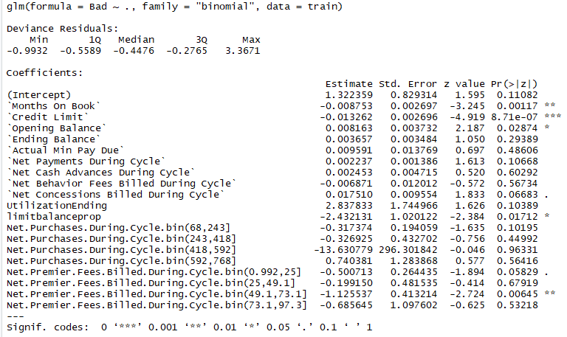
Logistic regression result
We randomly sample data into train and test with 8% and 20% customer for all model.
Two bin, two new and all others from model.
All date and some others irrelevant variables are dropped
Months on book, credit limit, opening balance are siginificant.

Slide 5
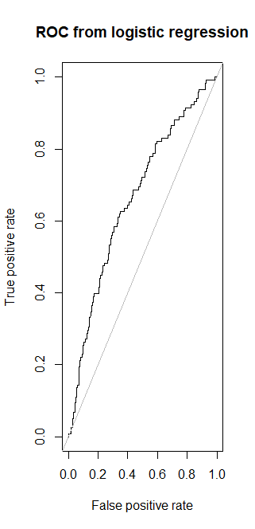
ROC for regression model
Misclassification rate is 0.1051
AUC is about 0.6640

Slide 6
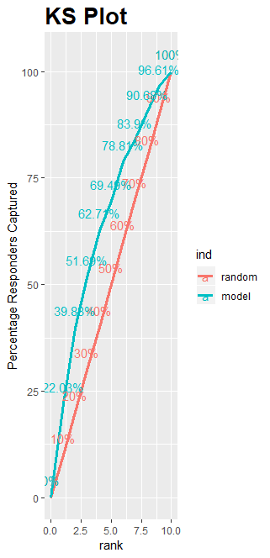
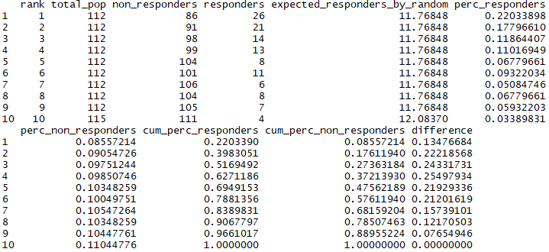
KS stat and KS plot from Logistic regression

Slide 7
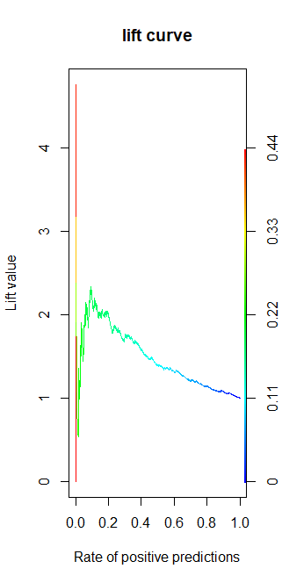
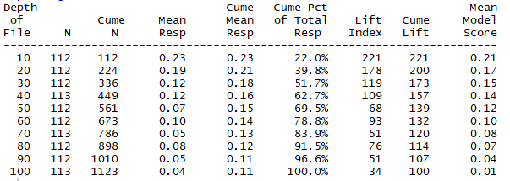
Lift curve and gains table from logistic regression

Slide 8
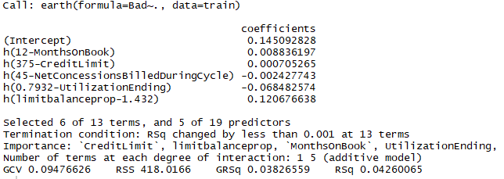
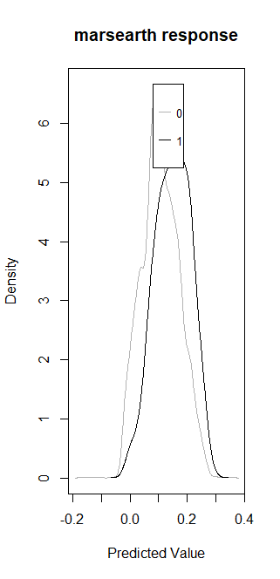

Summary of MARS model and response

Slide 9
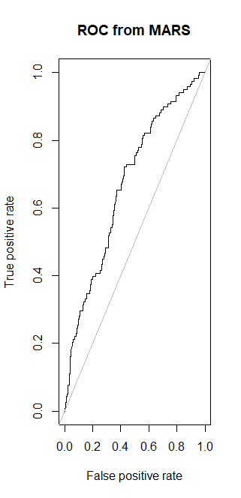
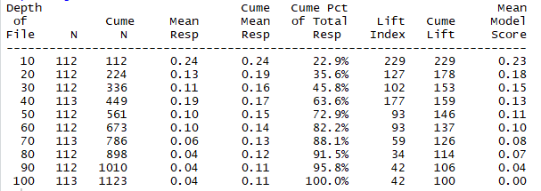
Gains table and ROC from MARS model

Slide 10
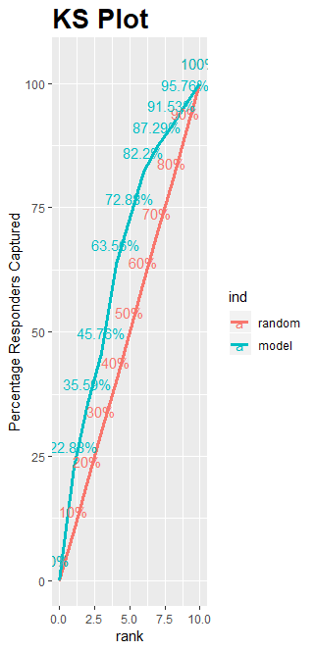
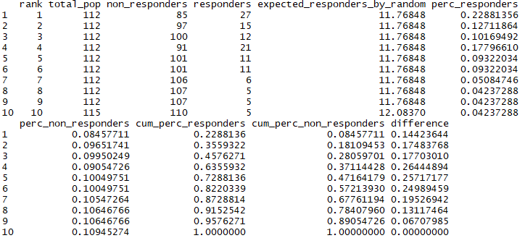
KS stat and KS plot from MARS model

Slide 11
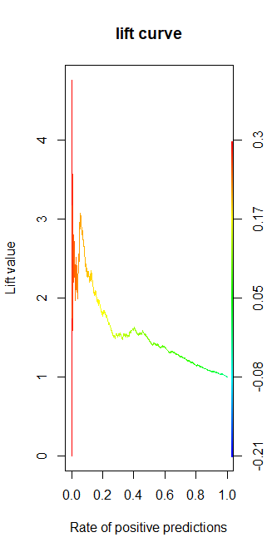
Lift curve from MARS model
Misclassification rate is 0.1051
AUC is about 0.6704

Slide 12
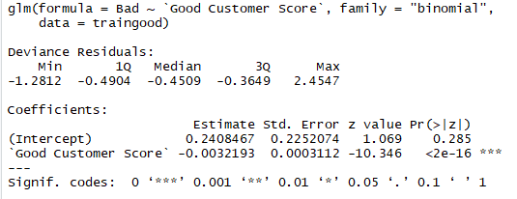
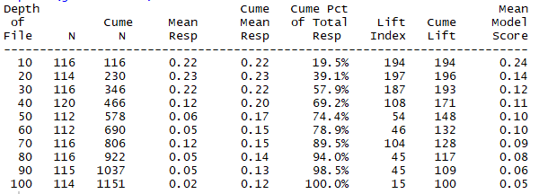
Good customer score in logistic model
Misclassification rate is 0.1164
AUC is about 0.69
MARS also produce similar result
Gain table from log good model

Slide 13
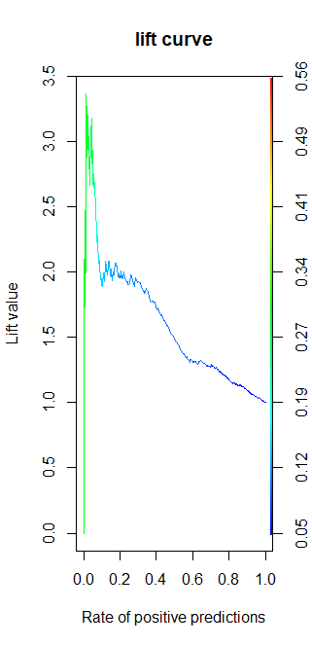
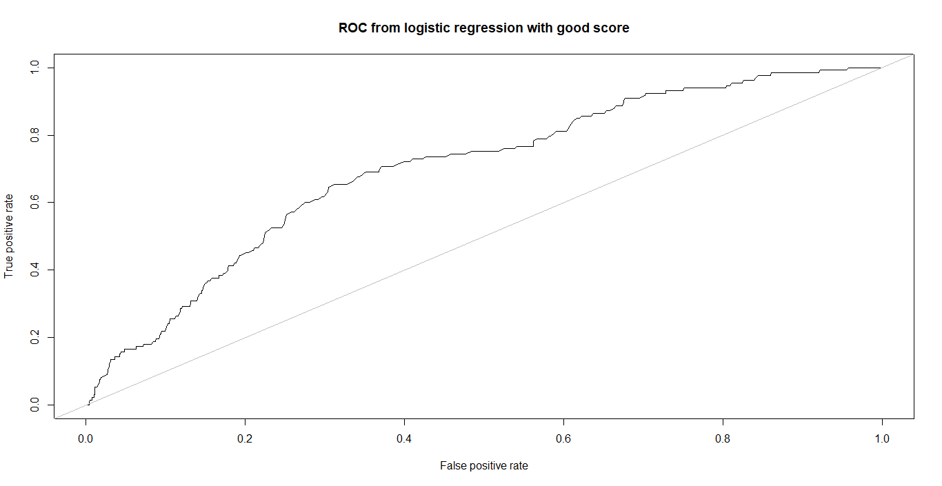
ROC and lift from good customer score model

Slide 14
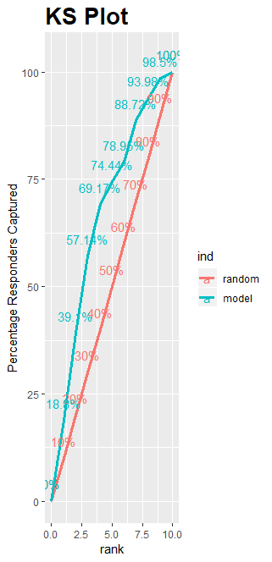
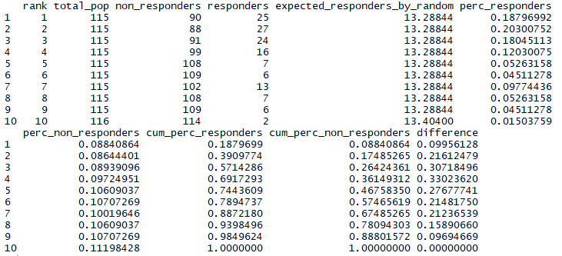
KS stat and KS plot from good customer score model

Slide 15
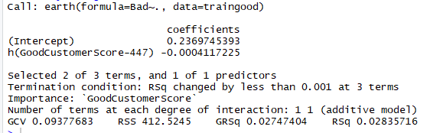
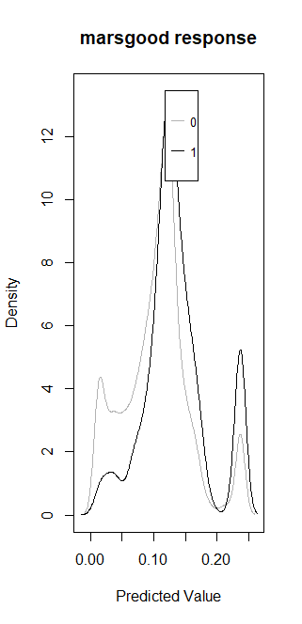
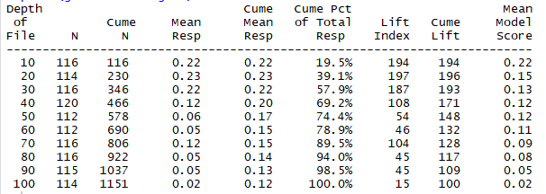
Summary of good customer score with MARS model
Misclassification rate is 0.1156

Slide 16
Profit from good and bad customer
283295407$ dollar from good customer from 5200 good customer
21210068$ from 628 bad customer
If we remove bad customer, still we are able to make money.
This amount can be about 262085339$
We can give some sort of incentive to good customer
We are still making money
All 4 models including good customer scores are almost similar in terms of misclassification, accuracy and other statistics
By comparing with good score model and our models, our model is perform better
We beat Rex Pruitt? Yes but not too strong.

